Slide 1
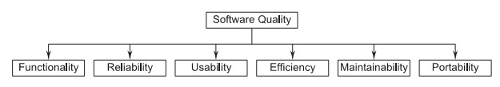
Software Quality Attributes
Software quality is comprised of six main attributes
(called characteristics)-
for Software products, these attributes can be
defined as follows.

Slide 2
Software Quality Attributes-
Functionality: The capability to provide functions which meet
stated and implied needs when the Software is used.
Reliability: The capability to maintain a specified level of performance.
Usability: The capability to be understood, learned, and used.
Efficiency: The capability to provide appropriate performance relative to the amount of resources used.
Maintainability: The capability to be modified for purposes of making corrections, improvements, or adaptation.
Corrective, Adaptive, Perfective.
Portability: The capability to be adapted for different specified environments without applying actions or means other than those provided for this purpose in the product.
.

Slide 3
Software Engineering Process
Sequence of steps required to develop or maintain software.
A Software process is the related set of activities and processes that are involved in developing and evolving a Software system.
A set of activities whose goal is the development or evolution of Software.
A Software process is a set of activities and associated
results, which produce a Software product.
A process defines who is doing what, when and how to reach a certain goal.

Slide 4
Fundamental Software Process Activities
Common to All Software process-
Software Specifications-
The functionality of the Software and constraints on its operation must be defined.
Software Development-
Software that meets the specifications must be produced.
Software Validation-
The Software must be validated to ensure that it does what the
customer wants.
Software Evaluation-
The Software must be develop to meet changing customer needs.

Slide 5
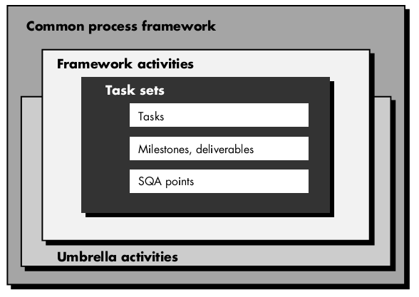
Software Process Framework
CSE@HCST 4/27/2016

Slide 6
Umbrella Activities (after deployment)
Software project tracking and control.
Formal technical reviews.
Software quality assurance.
Software configuration management.
Work product preparation and production (activities to create models, documents, logs, forms, lists, etc.).
Reusability management (defines criteria for work product
reuse and establish mechanisms to achieve component reuse).
Measurement.
Risk management.

Slide 7
Identifying a Task Set
A task set defines the actual work to be done to accomplish the objectives of a software engineering action.
A list of the task to be accomplished
A list of the work products to be produced
A list of the quality assurance filters to be applied

Slide 8
Software Process Characteristic
Software Process Characteristics are-
Understandability
Visibility
Robustness
Reliability
Acceptability
Maintainability
Rapidity
Supportability

Slide 9
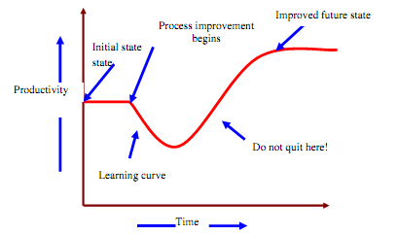
Software Process
The software process is the way in which we produce software.
Why is it difficult to improve software process ?
• Not enough time
• Lack of knowledge
• Wrong motivations
• Insufficient commitment

Slide 10
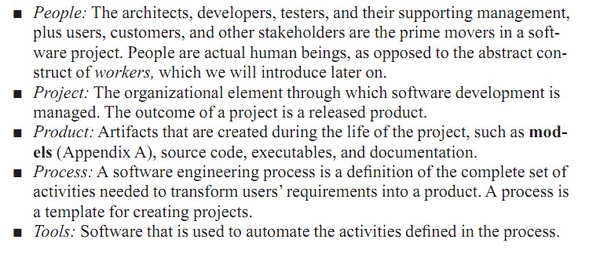
Role of Management in Software Development

